Slide 1


Genome Assembly of Hypomesus transpacificus (delta smelt)
Shannon EK Joslin
03 October 2019
Michael R. Miller, Alisha Goodbla and Amanda Finger
University of California, Davis
@IntrprtngGnmcs
@shannonekj
Notes:
Hi everyone my name is Shannon Joslin and today I will be talking about the genome assembly of Hypomesus transpacificus or Delta Smelt

Slide 2
Delta Smelt Background
Osmeridae
Endemic to the San Francisco Estuary (SFE)
Population has been declining since 1970s
Federally Threatened, State Endangered
Captive population at the Fish Culture and Conservation Lab
Monitored through physical surveys of the SFE
Illustration: National Geographic
Notes:
Before I go into the details of our genome assembly I’d like to give some background on delta smelt.
They are a small species of fish in the osmeridae family that are about the size of your finger .
They are native to the San Francisco Estuary in Northern California and their populations have been declining since the 1970’s which has led them to be listed as federally threatened and state endangered.
Currently, there is a captive population at the Fish Culture and Conservation Laboratory in the southern portion of the San Francisco Estuary
and the abundance of Delta Smelt are monitored through physical surveys of the SFE.

Slide 3
Why are genomes important?
Catalogue and protect Earth’s biodiversity
Gain a larger understanding of biology and evolution
Create new resources for human welfare
Notes:
The sequencing and assembly of organism’s genomes especially that of endangered species is important for
cataloguing and protecting Earth’s biodiversity,
allowing us to gain a larger understanding of biology and genetic mechanisms of evolution
and gives us the ability to create new resources in medicine for human welfare

Slide 4
Previous genetic analyses used partial RAD-seq assemblies.
Notes:
Genomes can also allow researchers to better monitor wild and endangered populations. Here we have a plot of the effective population size estimates made without a reference genome and we can see that there are wide confidence intervals and sizable differences of yearly estimations. By having a reference genome and knowing linkage patterns for the loci under study we can be more precise and accurate with estimates of population genetic statistics.

Slide 5
Genome Assembly Workflow
Sequencing
Assembly
…
Sequencing
Re-Assembly
…
Linked-Read
(10X)
Supernova
10X
Tigmint
Sample
HMW gDNA extraction
FALCON
PacBio
miniasm
Genome!
Canu
Oxford Nano
ARCS
Long Reads
(PacBio & Oxford Nanopore)
Illumina
ABySS
Lachesis
Hi-C
+ quality control at each step!
Notes:
There is no one-size fits all workflow for genomes assembly in different organisms. Various initiatives such as the Earth Biogenome Project or the Vertebrate Genome Project have sought to guide what kind of sequencing is the *gold* standard for genome assembly. However, each genome project will have certain limitations based on the project’s budget, ability to sample organisms and complexity of the organism’s genomic architecture.
All workflows for genome assembly starts with sampling and move onto extracting high molecular weight genomic DNA.
From here assembly workflows may differ in what sequencing technology makes the most sense for their organism.
Linked read sequencing, such as 10X, is a pseudolong read technique based on Illumina sequencing and can be beneficial for individuals with organisms that have a small amount of starting material and fairly simple genomic architecture.
Long read sequencing, such as PacBio or Oxford Nanopore, are great sequencing techniques where starting material is not an issue or if organisms have more complex genomic architecture. However, they are more expensive than Illumina based sequencing.
After sequencing, the raw reads must be assembled into an initial draft assembly using software relevant to the chosen sequencing technology.
Due to each technology having limitations, another form of sequencing usually follows an initial draft assembly with an additional re-assembly step. Illumina sequencing can be helpful in resolving errors with long reads or hi-c chromatin confirmation capture can be useful to scaffold contigs together.
And hopefully after all that work and all that money one will have a fairly high-quality reference genome!

Slide 6
Delta Smelt Assembly Workflow
Sequencing
Assembly
…
Sequencing
Re-Assembly
…
Linked-Read
(10X)
Supernova
10X
Tigmint
Sample
HMW gDNA extraction
FALCON
PacBio
miniasm
Genome!
Canu
Oxford Nano
ARCS
Long Reads
(PacBio & Oxford Nanopore)
Illumina
ABySS
Lachesis
Hi-C
We sampled one female and one male
Notes:
We began our delta smelt assembly workflow by sampling back muscle tissue from one female and one male Delta Smelt from the captive population.

Slide 7
Delta Smelt Assembly Workflow
Sequencing
Assembly
…
Sequencing
Re-Assembly
…
Linked-Read
(10X)
Supernova
10X
Tigmint
Sample
HMW gDNA extraction
FALCON
PacBio
miniasm
Genome!
Canu
Oxford Nano
ARCS
Long Reads
(PacBio & Oxford Nanopore)
Illumina
ABySS
Lachesis
Hi-C
Notes:
We then extracted high molecular weight genomic DNA from both samples.

Slide 8
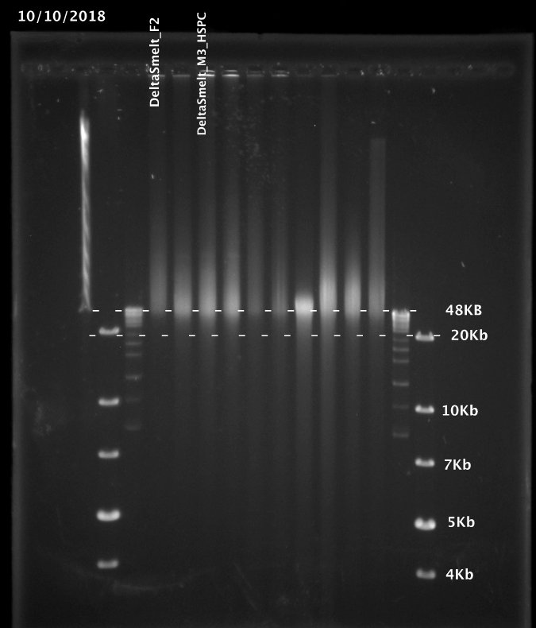
Extracted high molecular weight genomic DNA
Female
Male
Pulse field gel run for 24 hours
Female sample had sufficient DNA over 48Kb
48Kb
20Kb
10Kb
7Kb
5Kb
4Kb
Notes:
In order to have high contiguity in our initial assembly, extracting fragments of DNA over 48Kb is preferred. Here we have our extracted DNA run out on a pulse field gel from a female delta smelt in lane 1 and a male delta smelt in lane 3. The female sample had sufficient extracted DNA over 48Kb in length while the male individual had more highly fragmented DNA. So, we proceeded with sequencing library prep on just the female sample.

Slide 9
Delta Smelt Assembly Workflow
Sequencing
Assembly
…
Sequencing
Re-Assembly
…
Linked-Read
(10X)
Supernova
10X
Tigmint
Sample
HMW gDNA extraction
FALCON
PacBio
miniasm
Genome!
Canu
Oxford Nano
ARCS
Long Reads
(PacBio & Oxford Nanopore)
Illumina
ABySS
Lachesis
Hi-C
Notes:
For sequencing the delta smelt genome we chose to use 10X Genomics linked-read sequencing due to having a limited starting material.

Slide 10
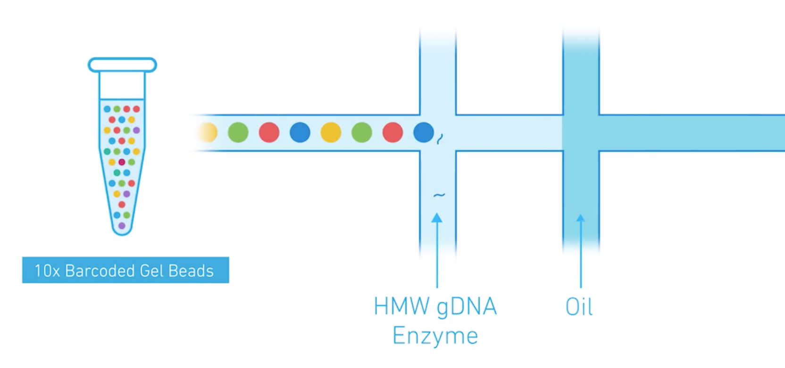
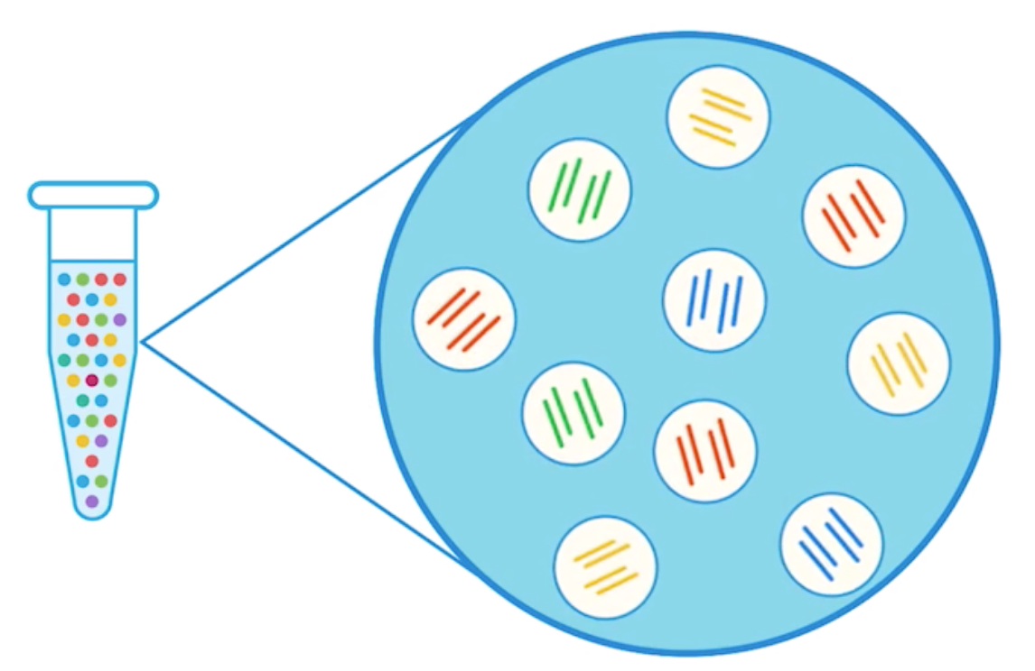
Linked-read technology provides pseudo long reads from Illumina Sequencing
Notes:
Linked-read sequencing creates pseudolong reads by taking individual fragments of high molecular weight DNA and encapsulating each into a unique gel emulsion bead. Within each bead, the initial fragment of high molecular weight DNA is further sheared into a size that can be capture by illumine sequencing. Then each sequence is barcoded to identify which bead it came from.

Slide 11
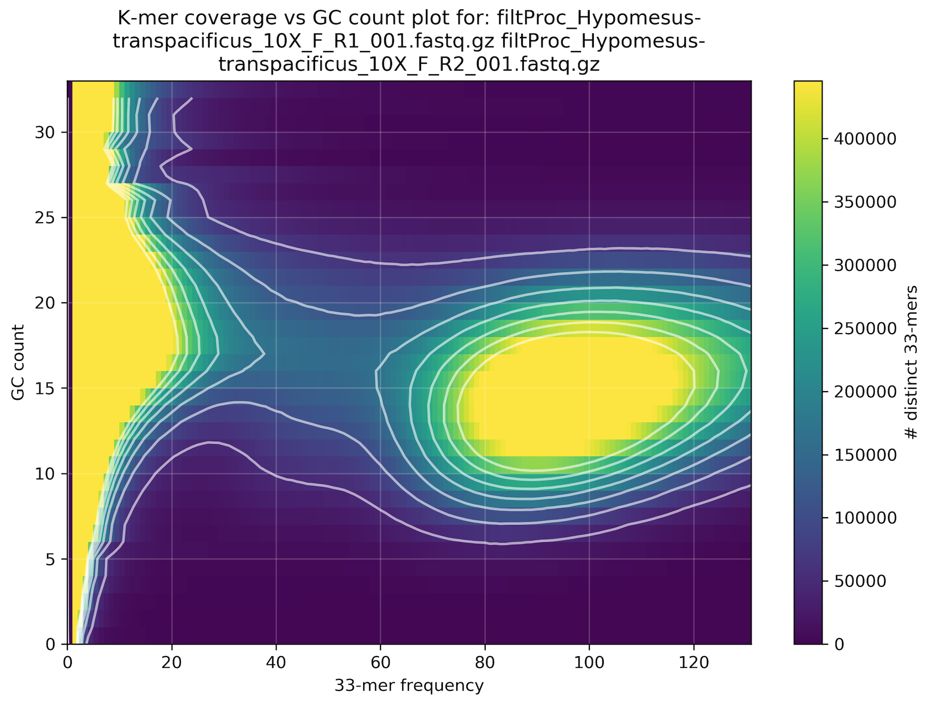
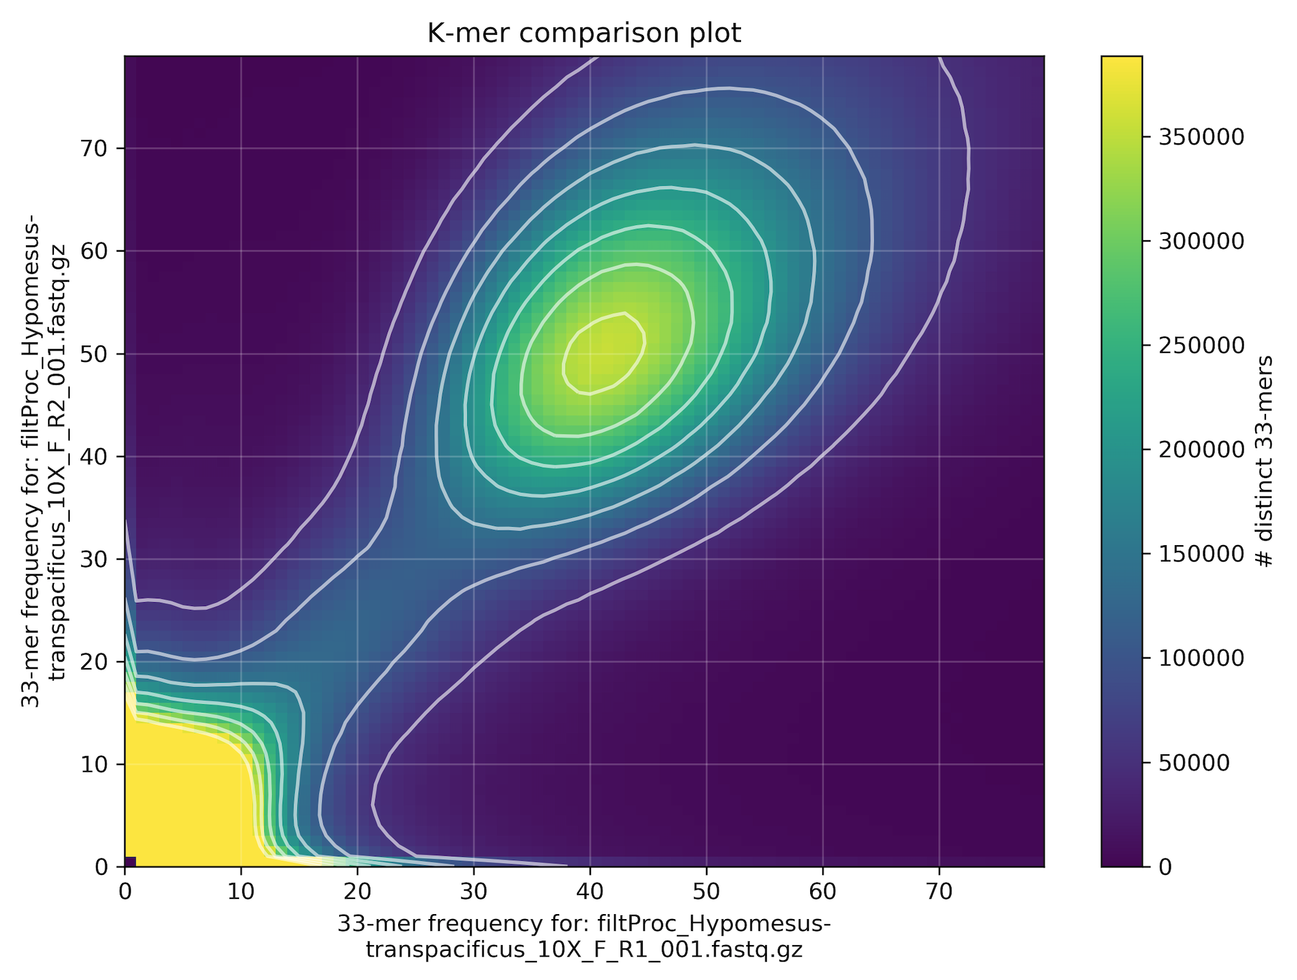
Raw sequence data showed no evidence of contamination.
Distinct
33mers
R2 33mer Freq
GC Count
R1 33mer Freq
33mer Frequency
Notes:
We tested our raw sequencing data for contamination using the software kmer analysis toolkit or KAT. We found no signs of contamination when comparing our 33mer frequency in R1 reads to R2 reads nor did we find signs of contamination when we looked at the GC composition of 33mers in all of our raw reads.

Slide 12
Delta Smelt Assembly Workflow
Sequencing
Assembly
…
Sequencing
Re-Assembly
…
Linked-Read
(10X)
Supernova
10X
Tigmint
Sample
HMW gDNA extraction
FALCON
PacBio
miniasm
Genome!
Canu
Oxford Nano
ARCS
Long Reads
(PacBio & Oxford Nanopore)
Illumina
ABySS
Lachesis
Hi-C
Notes:
We used the software Supernova to assemble our raw reads into contigs and scaffolds.

Slide 13
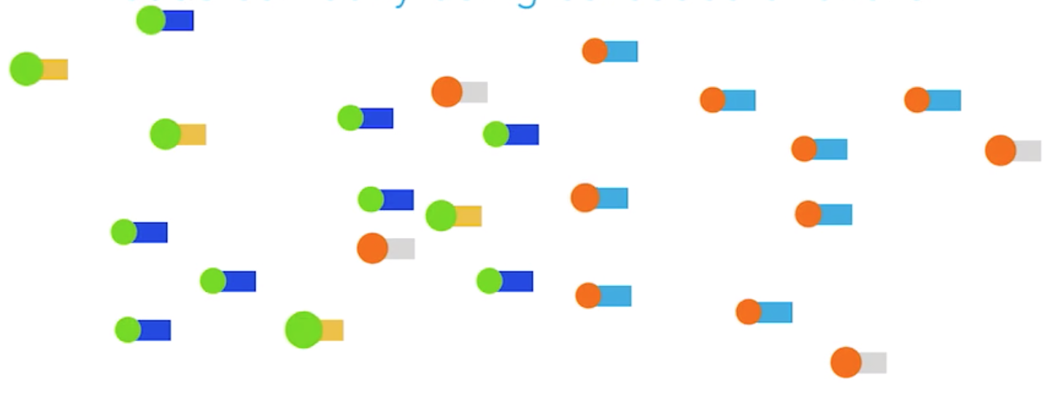
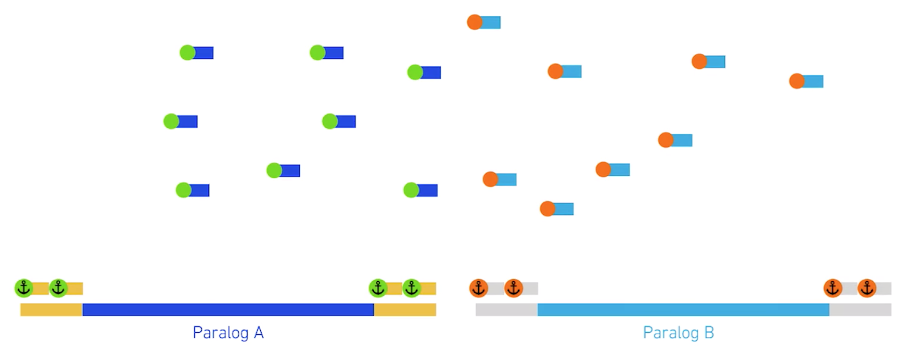
We assembled the linked-reads into a draft genome using supernova.
Sort by barcode
Notes:
Supernova works by taking barcoded reads and sorting them into individual miniassemblies based on the bead the barcode belongs to. This allows for Illumina sequencing to effectively behave as long reads and differentiate between paralogs throughout the genome. The pseudolong reads are then assembled into one final assembly.

Slide 14

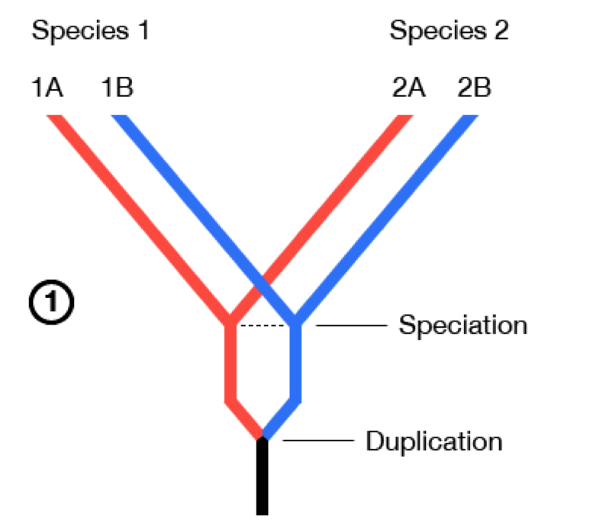
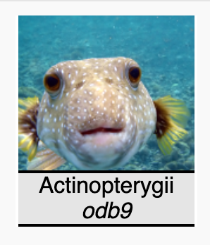
We tested assembled reads for completeness using single copy orthologs.
Speciation
Gene A
Gene B
4584 BUSCO Groups
Notes:
After running supernova we assessed the completeness of our linked-read assembly by running BUSCO.
BUSCO looks at the number of highly conserved single copy orthologs found within an assembly. We compared our assembly to the ray finned fish reference survey for the presence of 4584 BUSCO groups within our assembly.

Slide 15
The linked-read assembly is much better than previous RAD-seq derived assemblies.
Assembly | BUSCO Complete Genes | BUSCO Fragmented | Total Surveyed
RAD-seq | 0% | 0.7% | 0.7%
Linked Read | 87.8% | 5.8% | 93.6%
Notes:
We found our linked read assembly is much better than previous partial assemblies made solely with RAD sequencing data, which isn’t much of a surprise. However, we found our assembly to have 87.8% of the highly conserved single copy orthologs and 93.6% when we combine complete and fragmented genes captured in our assembly.
Previous RAD-seq assemblies only surveyed 0.7% of single copy orthologs. Which is expected but much, much less.

Slide 16
Assessing genome completeness with N50
N50: The minimum contig/scaffold length to cover 50% of the genome.
Genome
Assembly
50%
Linked-read Delta Smelt Assembly:
Contig N50 = 20.89 Kb
Scaffold N50 = 3,440 Kb
Notes:
Another way of assessing genome assemblies is through the use of the N50 summary statistic. N50 looks at the contiguity of assemblies and is defined as the minimum contig or scaffold length to cover 50% of the genome.
So if we have a genome here in blue (for the purpose of this definition we have a genome that is a single chromosome). And we have our assembly in orange, with each chunk being a different contig. The contig N50 of our assembly is the size of the contig wherever 50% of our base pairs lie. SO that would be the size of this third contig here.
The same logic applies when we look at the scaffold N50 of a genome but instead of looking just at the contigs we look at the size of the scaffolds.
Our linked-read assembly produced a contig N50 of 20.89 Kb and a scaffold N50 of 3,440 Kb.

Slide 17
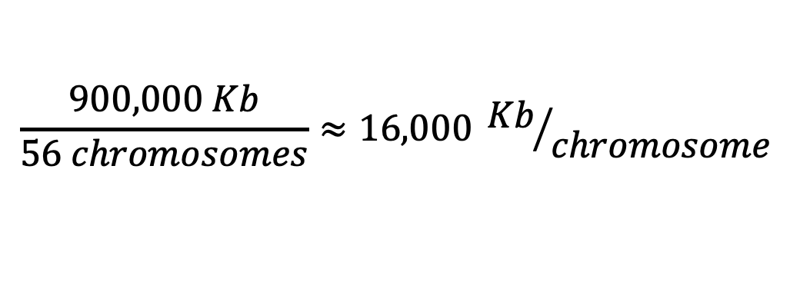
What do we need for chromosome scale contiguity?
56 Chromosomes
Genome Size: 900,000 Kb
$$\frac{900,000 Kb}{56 chromosomes}≈16,000 {Kb}/{chromosome}$$
So we still have a ways to go…
Notes:
But how big would we like these to be to have a chromosome level assembly in Delta Smelt?
Delta smelt have 56 chromosoms and a genome size of 900,000Kb
If we take the average chromosome length or 900,000 divided by 56 we get roughly 16,000Kb per chromosome.
So, we still have a ways to go in order to achieve a chromosome level assembly.

Slide 18
Delta Smelt Assembly Workflow
Sequencing
Assembly
…
Sequencing
Re-Assembly
…
Linked-Read
(10X)
Supernova
10X
Tigmint
Sample
HMW gDNA extraction
FALCON
PacBio
miniasm
Genome!
Canu
Oxford Nano
ARCS
Long Reads
(PacBio & Oxford Nanopore)
Illumina
ABySS
Lachesis
Hi-C
Notes:
In order to achieve a more contiguous assembly we have sequenced our samples using hi-c chromatin confirmation capture.

Slide 19
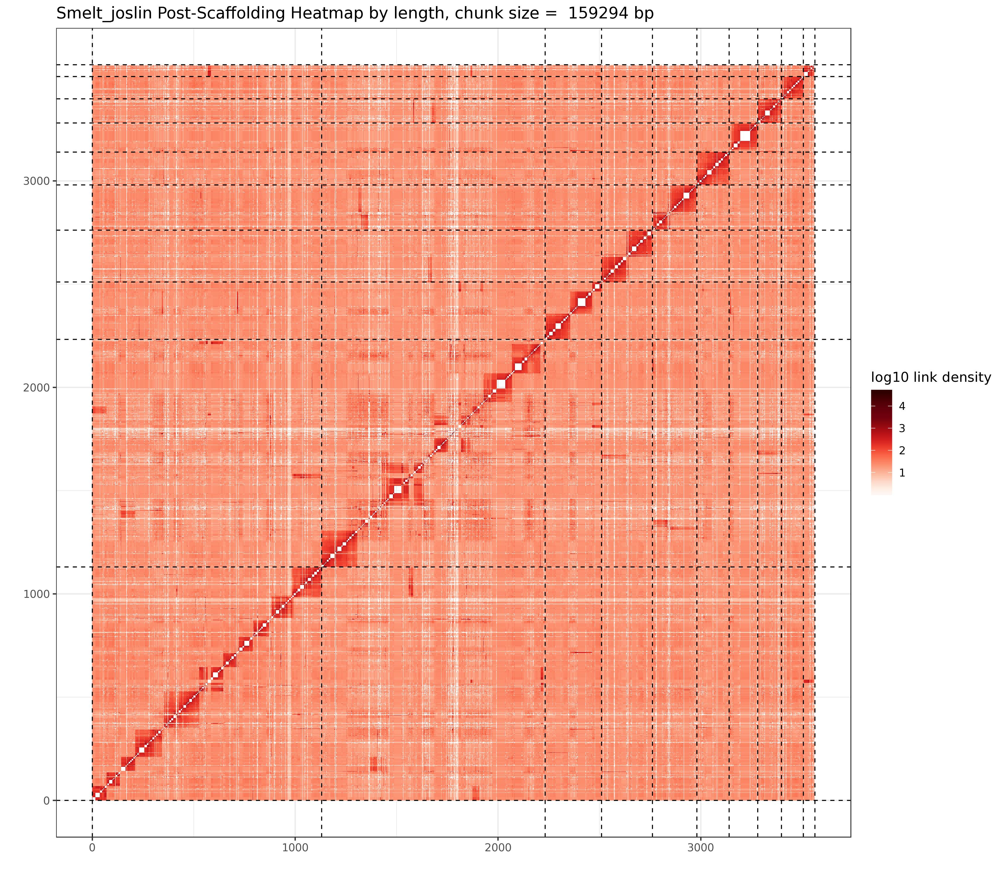
We can link contigs through hi-c
Notes:
Hi-c chromatin conformation capture crosslinks associated DNA within a cell. There is a linear relationship between the frequency of two pieces of DNA found to associate with one another and physical distance within the genome. Here we can see a heatmap of associated DNA.
Hi-c will allow us to find sequences of DNA on two different contigs in our linked-read assembly and scaffold them together based on the frequency of association of those two sequences within a cell.

Slide 20
Delta Smelt Assembly Workflow
Sequencing
Assembly
…
Sequencing
Re-Assembly
…
Linked-Read
(10X)
Supernova
10X
Tigmint
Sample
HMW gDNA extraction
FALCON
PacBio
miniasm
Genome!
Canu
Oxford Nano
ARCS
Long Reads
(PacBio & Oxford Nanopore)
Illumina
ABySS
Lachesis
Hi-C
Step Complete
In Progress
Notes:
We will use the program Lachesis to scaffold our linked-read assembly with our hi-c data in hopes that it will produce a chromosome level assembly.

Slide 21
Next steps
After the assembly is complete we can increase the precision and accuracy of population genetic estimations.
Investigation of domestication within captive colony
Identification of sex marker(s)
Photo: CA Dept. Water Resources
Notes:
After we have a high-quality reference genome we can increase the precision and accuracy of population genetic estimations
Investigate regions of domestication within captive delta smelt
And
Identify sex markers for the species.

Slide 22
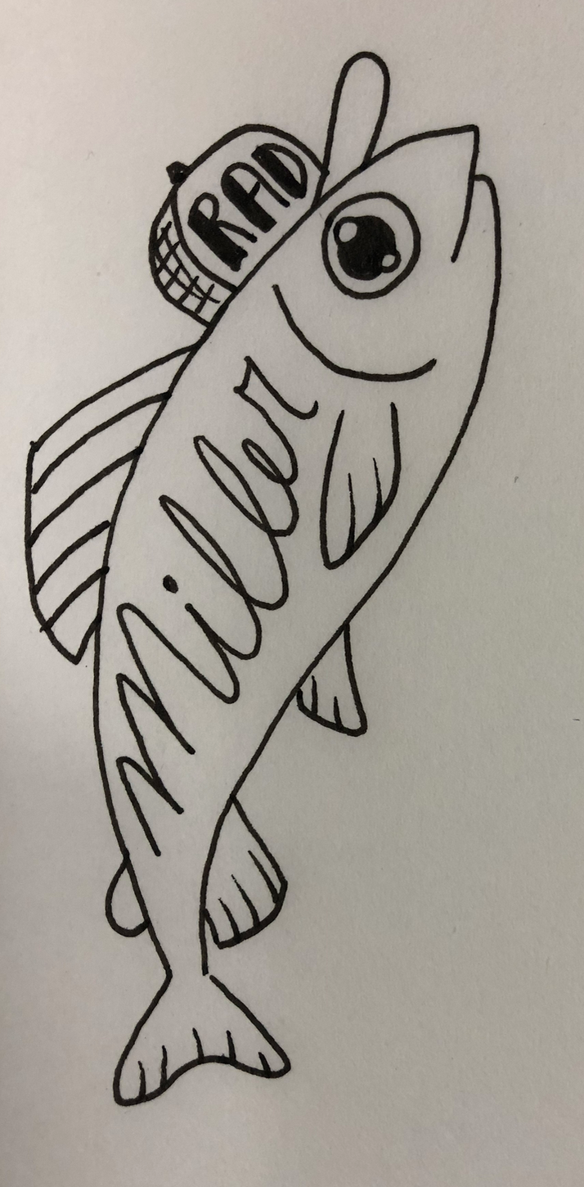
Thank you!
Contact: Shannon EK Joslin
sejoslin@ucdavis.edu
@IntrprtngGnmcs
State Water Contractors
Miller Lab
Genomic Variation Lab
Mandi Finger
Alisha Goodbla
Alyssa Benjamin
Ismail Saglam
Mike Miller
Andrea Schreier
Melinda Baerwald

